Slide 1
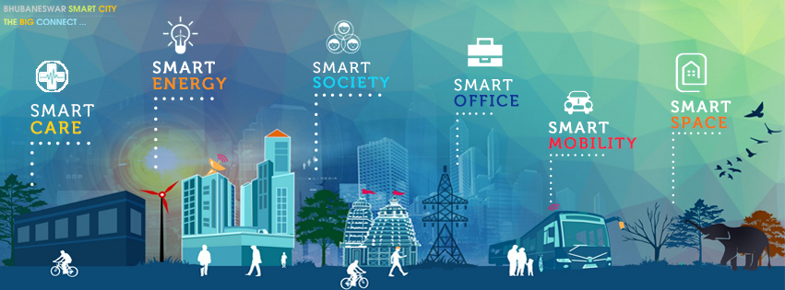

Crossing IOT Platforms For Extension Problem of Smart Environments
Binh Minh Nguyen
Hanoi University of Science and Technology
August 2018

Slide 2



Acknowledgements
Includes some joint work with Trinh Vu Tuyet, Duong Ha Quang, Quan Dinh Huu Hai, Thanh Do Duc, Hoan Vu Ngoc, Dong Ha Manh, Hieu Le
All experiments presented in this talk have been carried out at High Performance Computing Center, HUST

Slide 3
IoT Market Observations
Positive
Not so negative
- Cloud computing will provide unlimited resources
- SDN and NFV will help accelerate and scale IoT deployment
- Communities and International enterprises will lead standardization, regulation
- 5G will drive IoT deployments
- Too many “platforms” ➔ market requires consolidation
- Communities and International enterprises will lead standardization, regulation
- Data Security
- IoT Still at its Infancy in deployments & revenue
Assertion: in 2019, 2020 will see start to see a shift in focus towards deployments and monetization.

Slide 4
Figures
Over $100 Billion in IoT related investments in 2016
Qualcomm: invested over $50 Billion in the last 5 years ($47 B in 2016)
GE: Invested $1.5B+ in 2016
Vendors building their IoT products and service portfolios
Are we seeing the beginning IoT market consolidation?

Slide 5
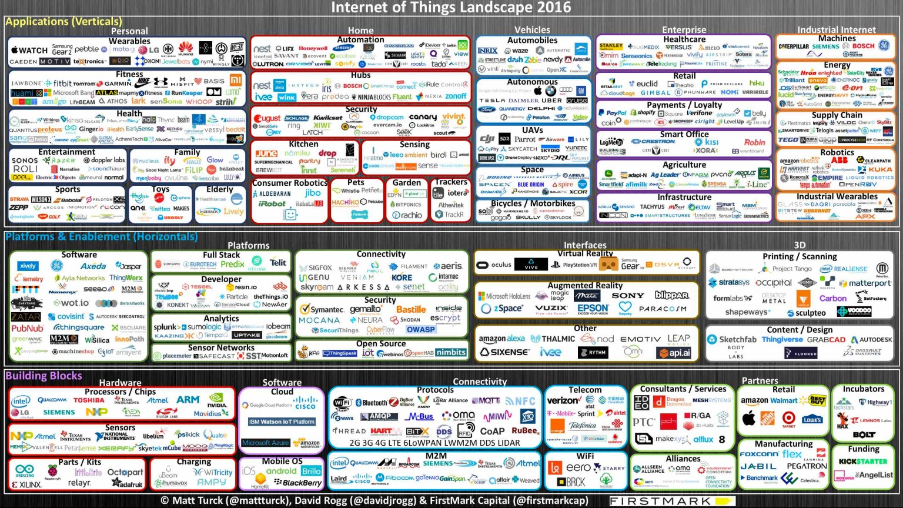

Slide 6
Addressed Problem
Too Many Platforms
360+ IoT Platforms estimated to exist in market today. 50+ from large/public multi-nationals and 200+ startups
Two Main Segments/Contexts
Technology Sector Focus
Semiconductors/Processors, Communications/Networking HW/SW, Developer Tools, Analytics
Industry Segments Focus
Home Automation, Health Care, Automotive and Autonomous Vehicles, Enterprises/Industrial/Manufacturing etc.

Slide 7

illustrated Scenario
A “smart” skyscraper with features:
Containing environmental sensors, electric devices and physical things
Networking is heterogeneous and ad-hoc.
All devices operate at the same time in different smart contexts ⬅ managed by multiple IoT platforms
➔ Motivation questions:
How can we manage things in heterogeneous environment with the intersection?
How does a thing join in and out the environment?

Slide 8
Integration will Create Differentiation
- Actually, context integration is a natural requirement
E.g. fire alarm in house/building, transportation accident alarm in tunnels
- How to integrate IoT platforms under single unified plane?
Platforms
Specific / differentiated features
Specific / differentiated features

Slide 9
Interoperability in IoT
Interoperability is critical to maximizing the value of Internet of Things. On average 40% of the total value that can be unlocked requires different IoT systems to work together.
“Some of the largest benefits of interoperability might be realized in the worksites setting, where the percentage of total value requiring interoperability approaches 60 percent. This large potential reflects the complexity and interconnectedness of the equipment.”
Source: McKinsey&Company

Slide 10
What is an IoT Platform?
An IoT Platform is an integrated suite of components that enable:
Development and deployment of applications
Interaction between devices (Things) and cloud applications
Remote data collection and analysis
Provide secure connectivity
Monitor, manage and control connected devices and infrastructure.
Integration with 3rd party systems

Slide 11

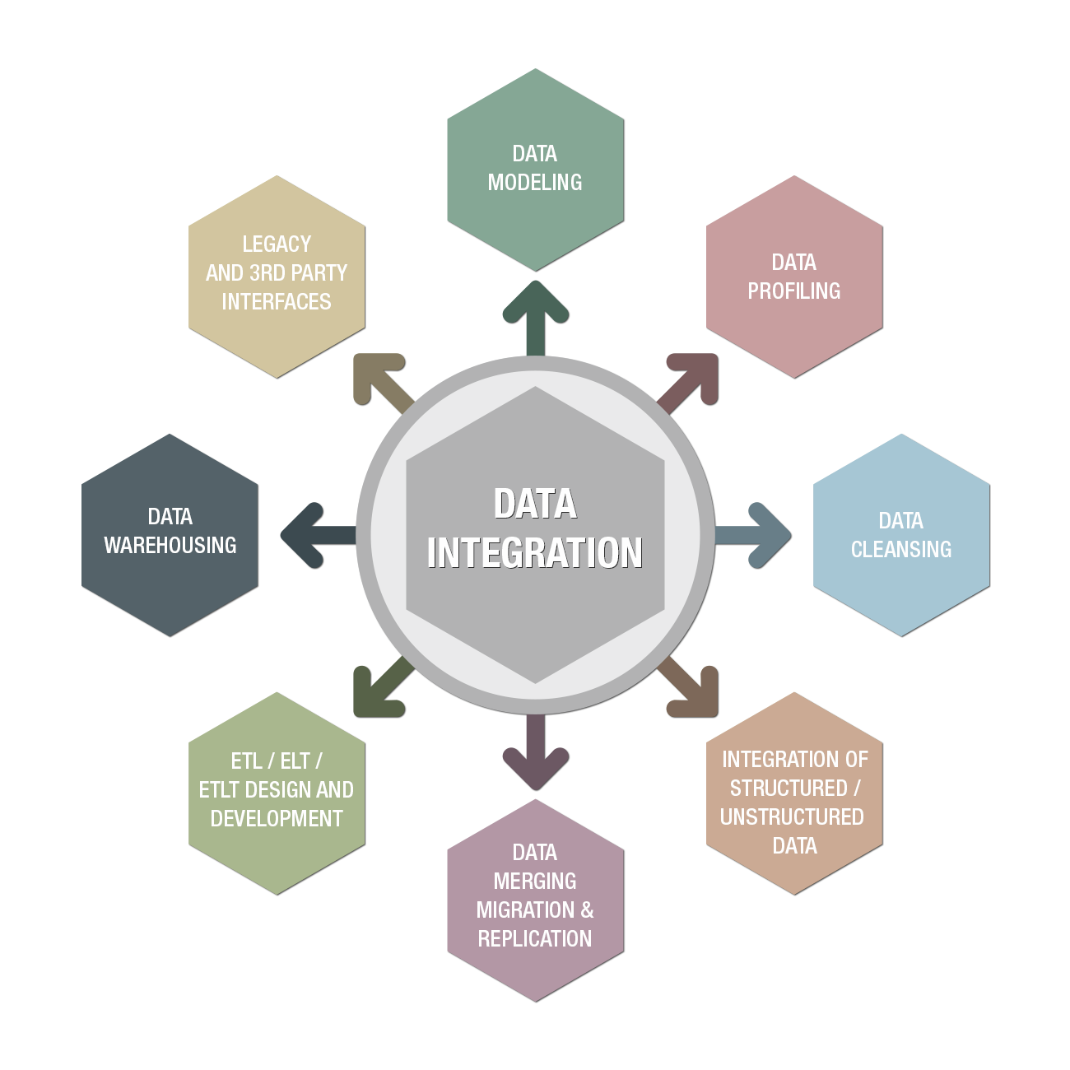

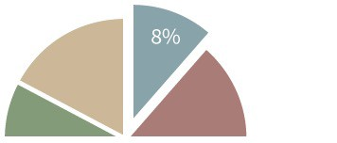



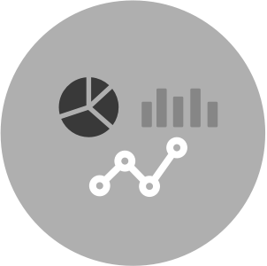



IoT Platform Reference Architecture
Devices/Sensors/Things/
Applications
Data Integration / Ingestion
Storage, Analytics, and Query
Visualization
Network/Connection
Security
LOTS OF TECHNOLOGIES, VENDORS, AND APPROACHES FOR EACH COMPONENT

Slide 12
Testbed - 3 different zones with diverse IoT platforms

Slide 13
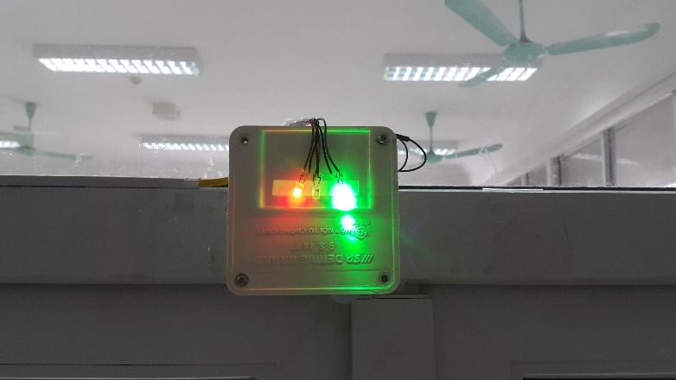
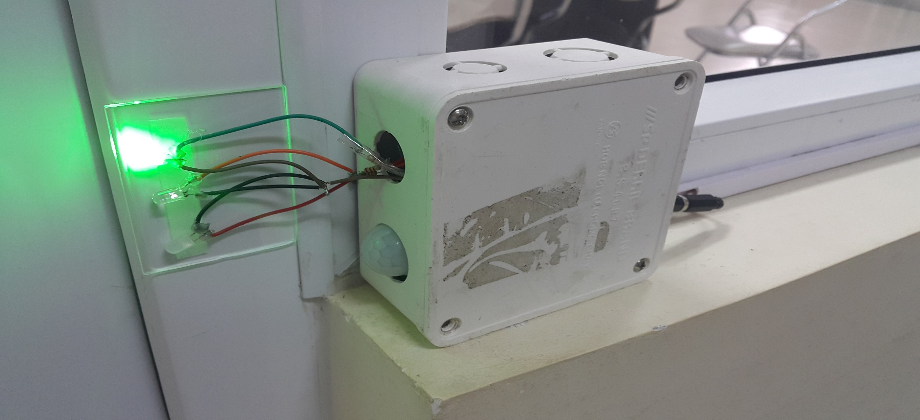

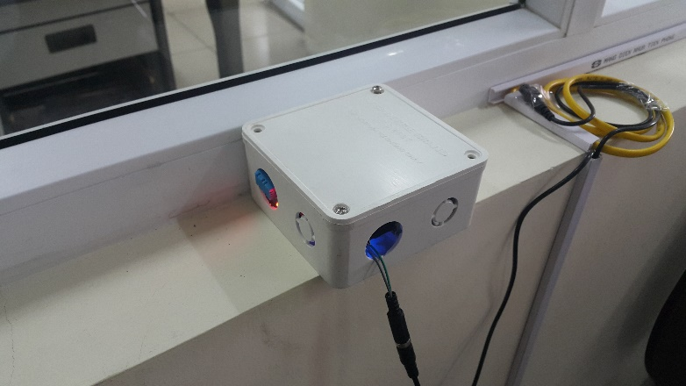
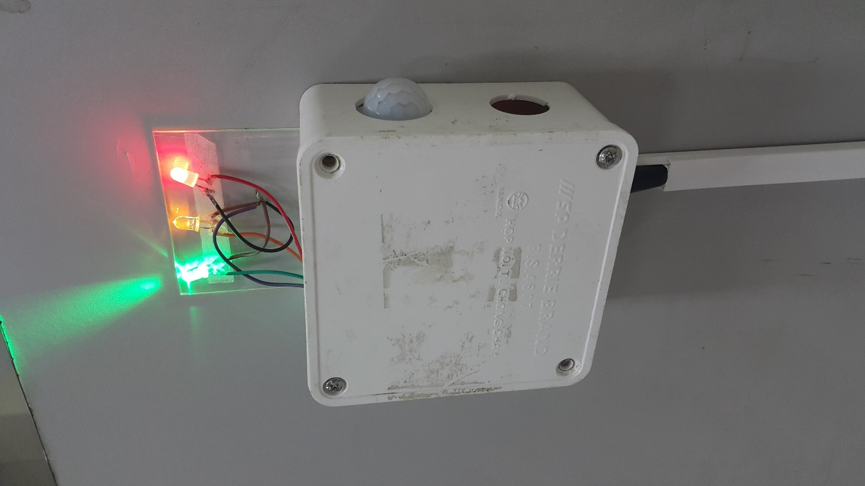


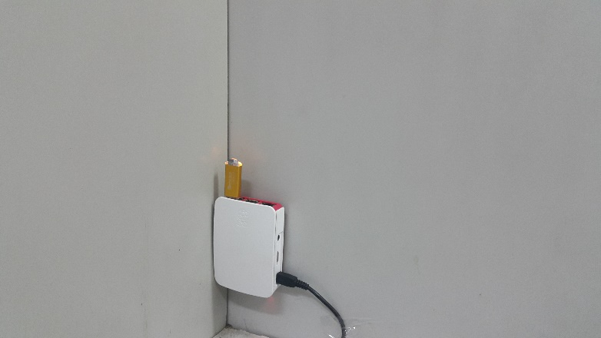
Testbed deployment

Slide 14

DEMO 1
Demo 1:
- 3 zones with 3 different platforms
- Integrating PAS system (OPENHAB Platform) into Cross IoT Platform Plane

Slide 15
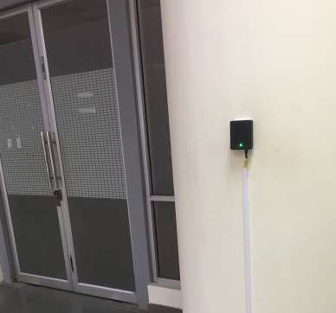
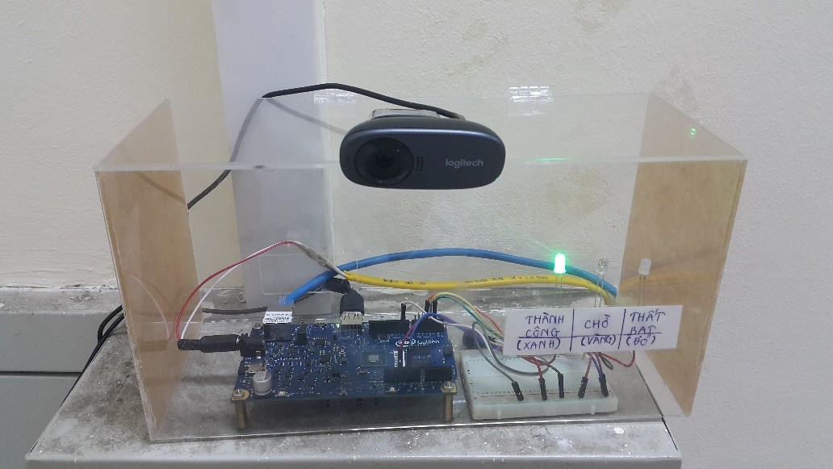
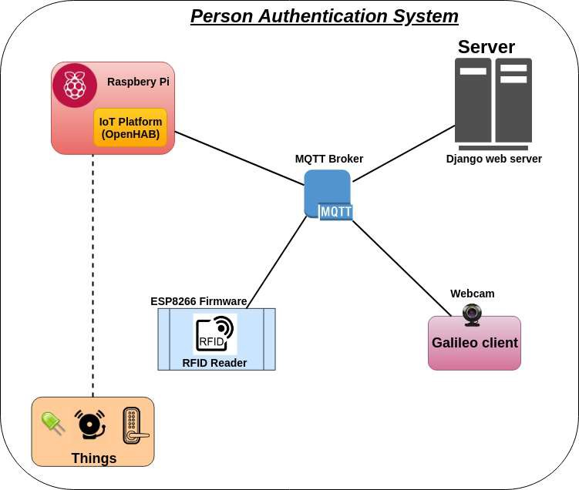
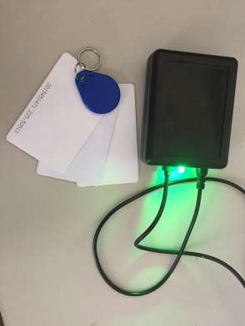
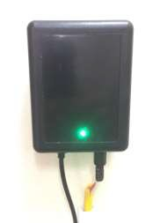
Person authentication system (PAS)

Slide 16
Crossing IoT Platform plane

Slide 17
Our solution - Core components
A software driver for each IoT platform types
Unified data model
Single unified API
Registration service
Other software blocks (data transformation, data filter, discovery, queues, semantic rule engine, monitoring, authentication, communication, …)
➔ Deploying the component in distributed environment of fog/cloud computing?

Slide 18
Overall Architecture

Slide 19





















<<enum>>
MetricType
<<enum>>
Time
<<has type>>
Metric
<<has type>>
Counter Histogram Gauge Summary
nanoseconds microseconds miliseconds seconds minutes
...
DataPoint
MetricName:String
MetricType Units DataPoint
<<has type>>
DataType PollingFrequency: Long Value: String
<<enum>>
DataType
<<has type>>
<<has type>>
<<enum>>
Units
<<provided by>>
<<enum>>
Data
<<provided by>>
Integer Float String Double
Log
Time
Data
Temperature
....
<<has type>>
Tag
Message
bits bytes kilobytes
megabytes
...
IoTSource
<<provided by>>
SourceId: String Endpoint: String State: String Description: String ResourceType: String Namespace: String Label: String Version: String
<<has type>>
Data Model
<<enum>>
...
<<enum>>
Temperature
TimeStamp
TimeStamp: long
...
Farenheit Celcius
...
<<inherit>>
<<inherit>>
<<inherit>>
<<inherit>>
<<inherit>>
Sensor
IoT Platform
Gateway
SensorType: String Manufacturer: String PlatformListener: String
Actuator
Things
PlatformName:String
PlatformType: String
GatewayName:String
GatewayType: String
...
...

Slide 20
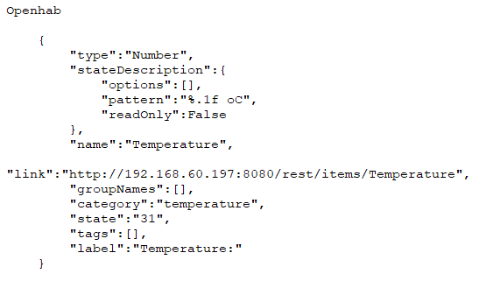
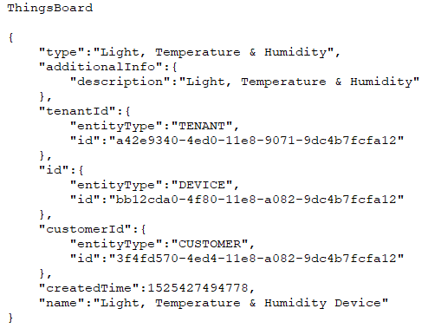
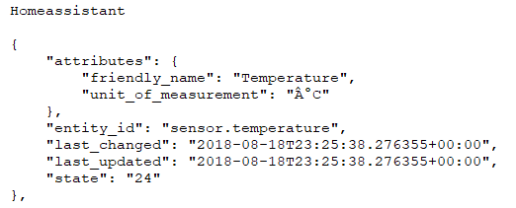
Data sources

Slide 21
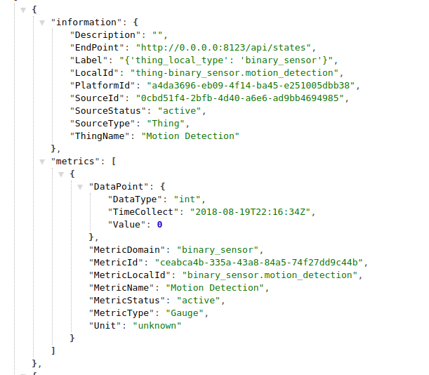
standardized data

Slide 22
Sematic control rule

Slide 23
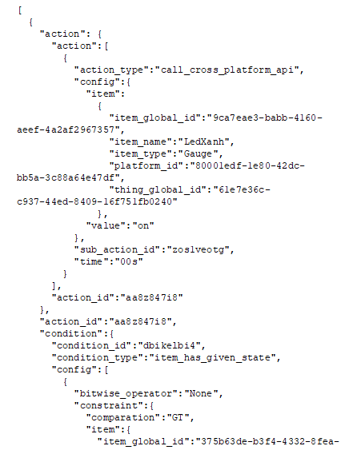
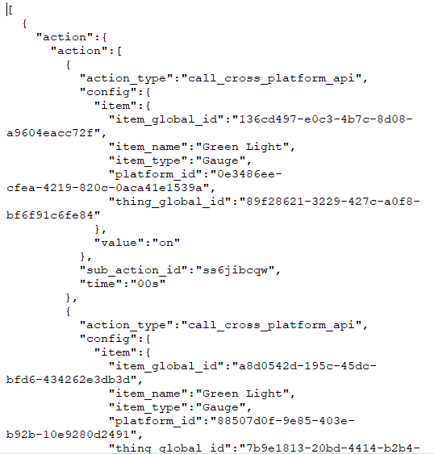
RULE DESCRIPTIONS

Slide 24
Demo Scripts
Demo 2: Simple semantics control rule (developing a cross-platform IoT application)
- Condition: if temperature in Server room > 10ºC (be always to test) – Home Assisstant platform
- Trigger: someone goes out from Staff room – ThingsBroad platform
- Action: turn on lights (green led) in Student room – OpenHab
App meaning: if server room condition is ok (temperature), and staff comes/leaves office (must go through student room ➔ turn on lights in student room for the staff
Otherwise, the app can trigger alarm in the server room condition is not OK

Slide 25
Demo Scripts
Demo 3: A more complex semantics control rule (developing other cross-platform IoT application)
- 4 different platforms as well as systems
- Condition: if temperature in Server room > 10ºC (be always to test) – Home Assisstant platform
- Trigger: someone comes in lab (taps his RFID card) – OpenHab platform (via PAS)
- Actions:
1/ Turn on light (green led) and turn on air-conditioner (red led) in Staff room – ThingsBroad platform
2/ Turn on light (green led) in Server room – Home Assisstant platform

Slide 26
Conclusions
Novel scenarios and service model: new techniques for provisioning and management of complex IoT
Strong extensibility
Lego services design (monitoring, data query, analytics, virtualization, …)
Cloud interoperability in IoT environment

Slide 27

Thank you
Contact:
minhnb@soict.hust.edu.vn
Published under Binh Minh Nguyen

